Slide 1
The American Health Care Act: Shoving Health Care Over the Cliff
Tennessee Charitable Care Network Spring Symposium
May 8, 2017
Gordon Bonnyman
Tennessee Justice Center

Slide 2
The Most Radical Change in American Health Policy in a Half Century
While focus is on repeal of ACA (Obamacare), radical restructuring of Medicaid is more momentous.
Congress won’t pass the AHCA unless it destroys Medicaid in its present form.
If the AHCA is amended to eliminate its worst elements, it cannot get enough right wing votes to pass.
The AHCA must be stopped. Congress must start over with a bill that genuinely repairs the ACA.

Slide 3
The Threat to Your Mission: Overwhelming Need, Fewer Resources
You will be overwhelmed by increased demand from newly uninsured and underinsured patients.
The hospitals, specialists and other resources to whom you refer patients will have less capacity to help. Rural areas’ situation will be especially dire.
A strong reaction to House version is needed to send message to Senators Alexander and Corker, who could be decisive in the Senate.

Slide 4
Context
Notes:
Antonio – heart failure at 42, one month after getting coverage on the ACA.

Slide 5
Goals of Speaker Ryan & Pres. Trump
Wealth transfers, via tax reform, from lower & moderate to higher income & corporations
Disinvestment in health >>> Investment in military
[Federal deficit reduction] – Important for Ryan, not so important for Trump.

Slide 6
Goals of Speaker Ryan & Pres. Trump
End of ACA, resulting in 24M more uninsured.
Elimination of the ACA’s consumer protections, civil rights requirements and insurance company regulations.
The Grand Prize: Nearly $1 Trillion in Medicaid cuts over next decade.

Slide 7
ACA Repeal: a Trojan Horse to destroy Medicaid
Medicaid is more efficient and lower cost than other third party payers. But it is still growing due to health care inflation and is seen by the Right as a culprit fueling the federal deficit.
As nation’s largest entitlement program benefiting the poor, dismantling Medicaid has been Holy Grail for the Right since Reagan era.
Medicaid reform is GOP’s single most important budget objective.

Slide 8
Present political status
Notes:
Antonio – heart failure at 42, one month after getting coverage on the ACA.

Slide 9
Drama in the House
GOP pledged Congress would pass ACA repeal and submit it to President Trump for him to sign on his first day in office, January 20.
Campaign demanding “no repeal without replace” was successful, forced Speaker Ryan to offer replacement as part of repeal bill.
The American Health Care Act (AHCA), sponsored by TN Congresswoman Diane Black, guts ACA and caps federal Medicaid funding.

Slide 10
Drama in the House – Round One
Enormous grassroots opposition to the AHCA from both Right and Left.
GOP Freedom Caucus and right wing groups opposed because did not go far enough. By end of March, only 17% of voters were in favor of the AHCA.
A dozen polls showed that support for the Affordable Care Act was at an all-time high.
On March 24, Speaker Ryan withdrew the AHCA temporarily.

Slide 11
Drama in the House – Round Two
Concessions to Right made bill even harsher by undermining pre-existing condition protections and essential health benefits.
The Freedom Caucus endorsed the revised AHCA, as did other right wing groups, like the Koch Brothers’ Americans for Prosperity.
Under intense pressure, enough moderates voted yes to pass the bill out of the House on May 4th and send it to the Senate.

Slide 12
What the AHCA means for TN
Notes:
Antonio – heart failure at 42, one month after getting coverage on the ACA.

Slide 13
AHCA’s Threats to Health Care
Congressional Budget Office projected an increase of 24 million uninsured Americans.
AHCA will cut $880 billion from Medicaid, shifting those costs from federal government to the states. It will cost TN’s state budget $500 million/year.
Makes inequities among states permanent, to the disadvantage of TN and Tennesseans.

Slide 14
What does this mean for Tennessee?
Number of uninsured Tennesseans will increase by 578,000.
Ends Medicaid expansion, keeps TN from joining 31 states that have expanded coverage under the ACA, leaves 280,000 still uninsured.
Widens income inequality
Notes:
Antonio – heart failure at 42, one month after getting coverage on the ACA.

Slide 15
Medicaid cuts affect TN’s Healthcare Infrastructure
1.5 M Tennesseans rely on TennCare for coverage.
61% of nursing home care is covered by TennCare.
Over half of births and half of all TN children are covered by TennCare.

Slide 16
AHCA Devastates Rural Communities
32 hospitals are at risk of closing and are highly dependent on Medicaid funding.
Medicaid enrollment rates 2X higher in rural areas.
Hospitals are among largest employers in a community, and closure makes it difficult to recruit other industry.
Without hospital, hard to recruit or retain other providers. Access to care suffers.
Loss of resources in places already hard hit by opioid epidemic.

Slide 17
Medicaid cuts affect TN’s WHOLE State Budget
Over 20¢ of ever dollar in state budget is federal Medicaid funding.
Proposed federal Medicaid cuts of $500 M per year, increasing in future years, are too big to handle just with TennCare cuts.
ALL aspects of the state budget, including K-12 and higher ed, will sustain cuts.

Slide 18
Pre-Existing Conditions
AHCA would take us back to the dark days when people with pre-existing conditions like diabetes and cancer couldn't get health insurance.
Allows insurers to charge more to those who need coverage most: the sick, and older people, making coverage unaffordable for many.
High risk pools have long record of failure.
1.2 million Tennesseans have pre-existing conditions that, before the ACA, would prevent them from getting coverage.

Slide 19
Essential Health Benefits
The bill allows states to get rid of the essential health benefits, which would roll back the clock to the days of skimpy plans without coverage for maternity care, substance use disorders or mental health services.

Slide 20
Big Issue – Medicaid – Is Overlooked
Pre-existing conditions and essential benefits are important.
So, of course, is the repeal of the ACA,
But those features pale compared to slashing Medicaid, which is the most sweeping change in American health policy in 50 years.
Will irreparably damage hopes for a more just and humane health care system.

Slide 21
Tennessee Now Takes Center Stage

Slide 22
Fate of Health Care Now in Senate
TN’s Senators Lamar Alexander & Bob Corker will be critical to efforts to block passage.
Senate plans to fashion bill in secret, without holding hearings, or getting meaningful input from knowledgeable stakeholders.
We must act NOW to persuade Sens. Alexander & Corker to lead responsibly. CRITICAL ASK: do not allow Senate vote without holding public committee hearings.

Slide 23
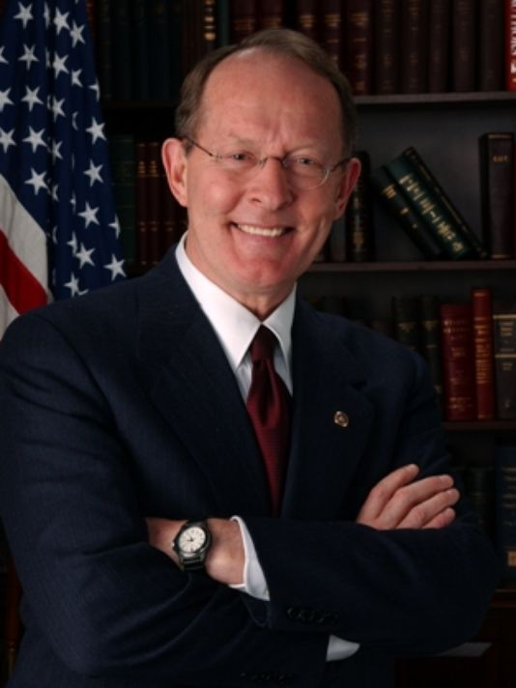
Senator Alexander
Heads important Health, Education, Labor & Pensions (HELP) Committee
Endorsed AHCA and said it could go to Senate floor without committee hearings.
Advocates for Medicaid spending cuts.
Notes:
Senator Alexander is the most important person in this conversation. He took a moderate stance in January by insisting that there should be no ACA repeal without simultaneous replacement. He has advocated for “repair” rather than replacement of the ACA and has been vocal in pushing for a legislative patch to stabilize insurance markets. But he stunned Washington insiders in March by praising Speaker Ryan’s House version of the American Health Care Act, by waiving hearings on the bill in his committee, and by urging Majority Leader Mitch McConnell to bring the bill straight to the Senate floor without any Senate committee review.

Slide 24
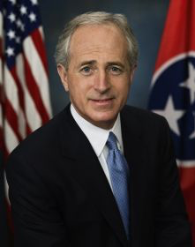
Senator Corker
Has pressed in the past for Medicaid cuts but was more moderate on the AHCA.
Generally follows Sen. Alexander’s lead on health matters.

Slide 25
Actions to stop the AHCA in Senate
Calls to both Senators voicing opposition and asking for public committee hearings.
Ask for in-person meeting with Senators or staff.
Letters to their in-state offices
Letters to the editor (we can help)
Op-eds in the newspaper (we can help).
Educate and engage your neighbors, church, etc.

Slide 26
Contact BOTH Senators
City | Senator Lamar Alexander | Senator Bob Corker
Chattanooga | Joel E. Soloman Federal Building 900 Georgia Avenue, #260 Chattanooga, TN 37402 Phone: (423) 752-5337 | 10 West MLK Blvd., 6th Floor Chattanooga, TN 37402 Phone: (423) 756-2757
Jackson | 111 Murray Guard Drive, Suite D Jackson, TN 38305 Phone: (731) 664-0289 | 91 Stonebridge Boulevard Suite 103 Jackson, TN 38305 Phone: (731) 664-2294
Knoxville | Howard H. Baker, Jr., U.S. Courthouse 800 Market Street, #112 Knoxville, TN 37902 Phone: (865) 545-4253 | 800 Market Street, Suite 121 Knoxville, TN 37902 Phone: (865) 637-4180
Memphis | Clifford Davis-Odell Horton Federal Building 167 North Main Street, #1068 Memphis, TN 38103 Phone: (901) 544-4224 | 100 Peabody Place, Suite 1125 Memphis, TN 38103 Phone: (901) 683-1910
Nashville | 3322 West End Avenue, #120 Nashville, TN 37203 Phone: (615) 736-5129 | 3322 West End Ave., Suite 610 Nashville, TN 37203 Phone: (615) 279-8125
Tri-Cities | Tri-Cities Regional Airport 2525 Highway 75 Suite 101 Blountville, TN 37617 Phone: (423) 325-6240 | 1105 East Jackson Boulevard Suite 4 Jonesborough, TN 37659 Phone: (423) 753-2263

Slide 27
The Message for Senators
Ask them to “repair” the ACA & protect Medicaid.
CRITICAL ASK: do not allow Senate vote without holding public committee hearings.
It would be irresponsible to rush without considering impact on TN.

Slide 28
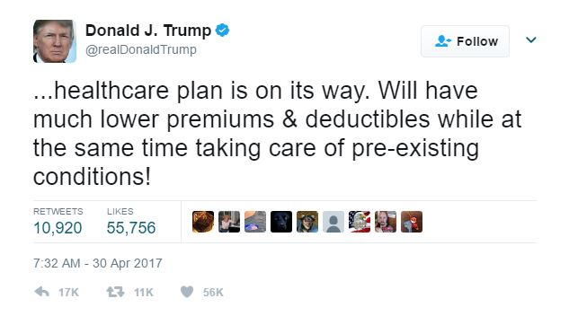
The Message for Senators
Honor President Trump’s pledge:

Slide 29
Questions?

