Slide 1



Assessing Early Dementia
How to Have the “ Car Key” Talk
Presented by Lynn Wood, Caregiver Support Coordinator
Notes:
Welcome and introduction of our organization and my program.

Slide 2
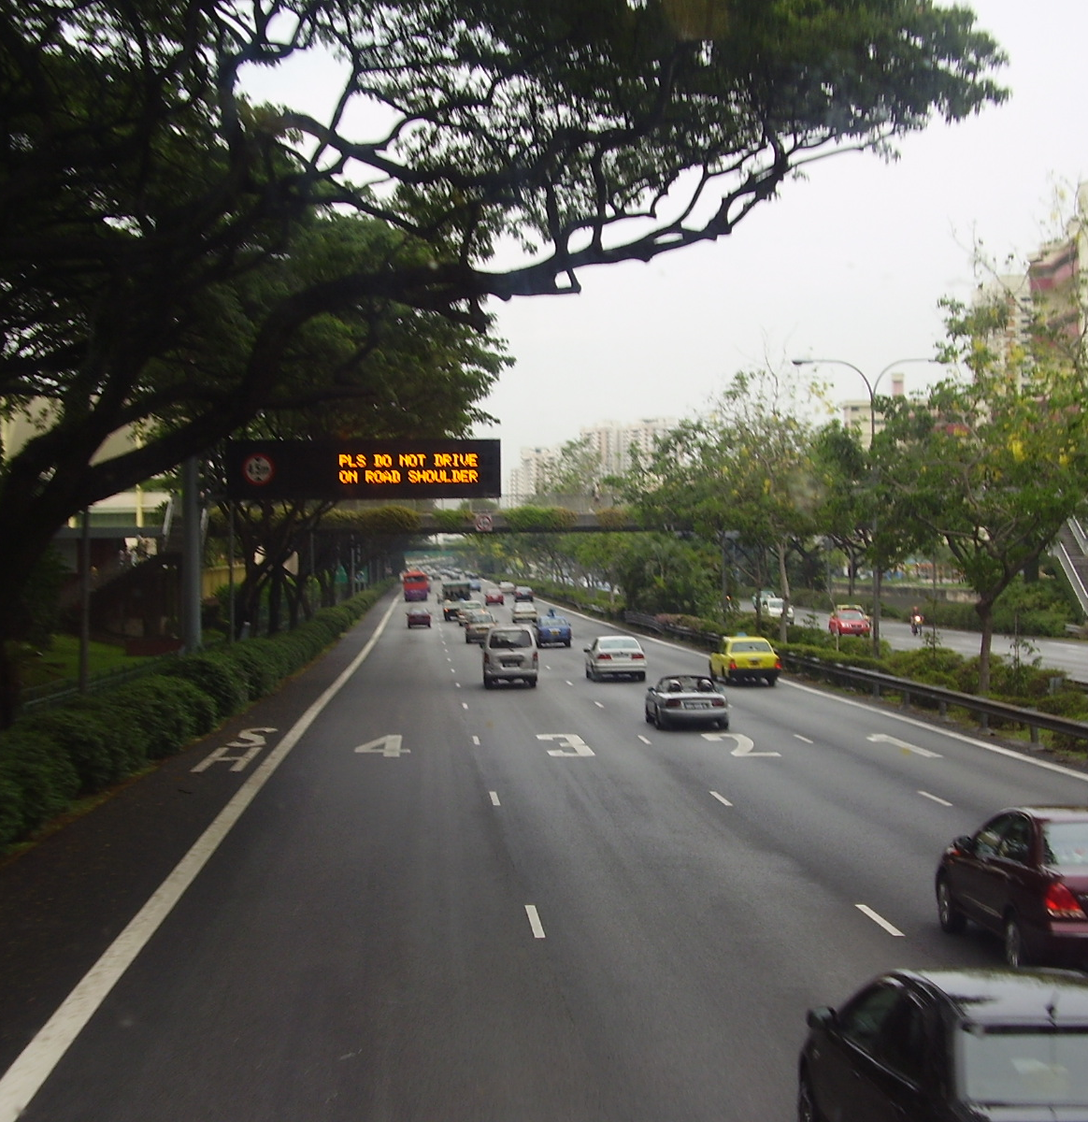
Objectives
Normal Aging vs Not Normal Aging
Early Signs of Alzheimer’s and other Dementias
Dementia and Driving
Having “The Talk”
Professional Help
This Photo by Unknown Author is licensed under CC BY-SA
Notes:
Go over the objectives for todays presentation.

Slide 3

What Is Normal Aging?
Normal Aging
Can’t recall a word. Describe the word to get it to pop up.
Give people time to process information. Go more slowly.
Slower to think.
Slower to do.
May hesitate more.
More likely to look before they leap.
Will know the person, but not find the name.
May pause when word finding
New data reminds me of old data
This Photo by Unknown Author is licensed under CC BY
Notes:
If we look at some of the signs we see if normal aging, we can see that even without a diagnosis of dementia driving might be a challenging.

Slide 4

Alzheimer’s Disease and other Dementias
Notes:
Universally, we look at Dementia as an umbrella and under that umbrella are all the different types (next slide)

Slide 5
Dementia
Genetic syndromes
Parkinson’s Disease
Vascular Dementia
Huntington’s Disease
Alzheimer’s Disease
Young Onset
Late Life Onset
Lewy Body
Creutzfeldt-Jakob
Drugs/toxin exposure
ETOH related
Pick’s Disease
Notes:
Mention that there are 85 to 90 different illnesses and diseases that can have “dementia” as a symptom

Slide 6


Not Normal Aging
Unable to think the same
Unable to do as before
Unable to get started on a task
Will get stuck in a moment of time
Unable to think things out
Unable to successfully place a person
Words won’t come even with visual, verbal, or touch cues
Confused between past and present
Personality and/ or behaviors will be different
This Photo by Unknown Author is licensed under CC BY
Notes:
Unlike what we call “normal aging” with dementia, tasks cannot be handled appropriately.

Slide 7
Dementia and Driving Difficulties
Notes:
Introduce the next objective on the steps on having the driving conversation.

Slide 8
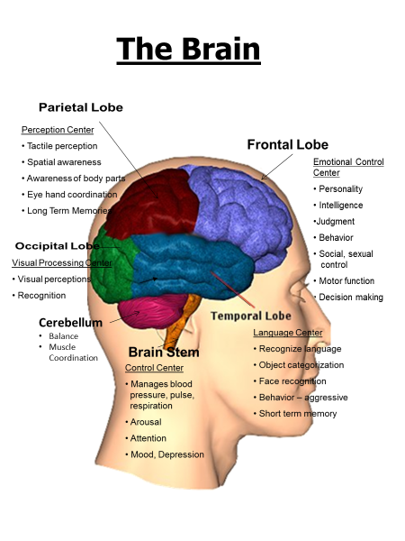
Alzheimer’s Disease and other Dementias
Notes:
When you drive, different regions of your brain cooperate with each other to accomplish the different driving functions. AND, those driving functions need to be complete pretty quickly. Spend some time on this slide to push the point on each section and how the information has to travel from lobe to lobe.
Ironically, you need the different regions of the brain to understand why retiring from driving may be necessary.

Slide 9
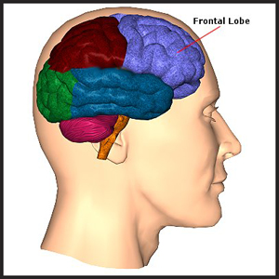
Emotional Control Center
Personality
Intelligence
Judgment
Behavior
Social, Sexual Control
Motor Function
Decision Making

Slide 10
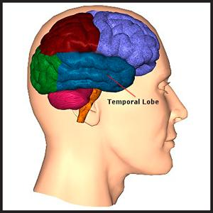
Language Center
Recognize language
Object Categorization
Face Recognition
Behavior-Aggressive
Short Term Memory

Slide 11
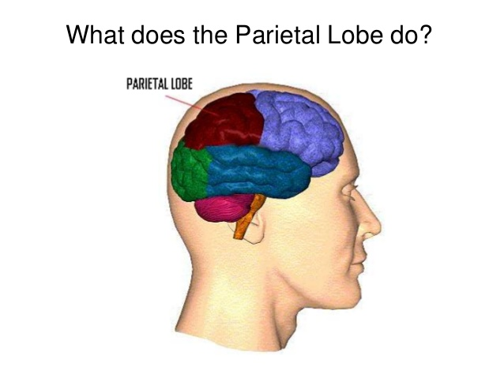
Perception Center
Tactile perception
Spatial awareness
Awareness of body parts
Eye hand coordination
Long Term Memories

Slide 12
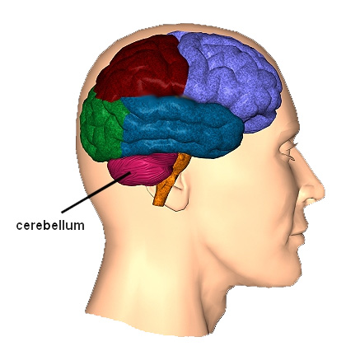
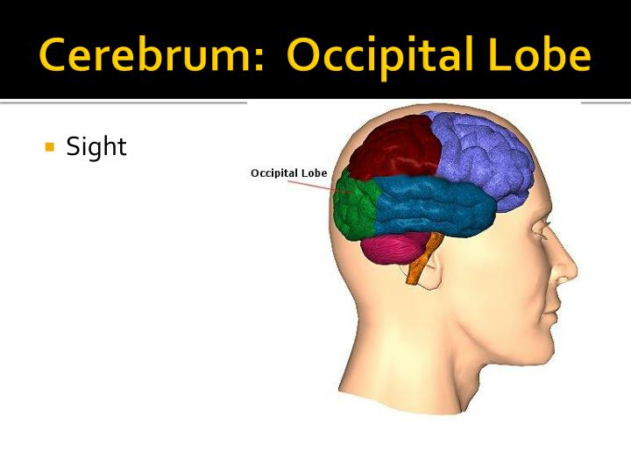
Visual Processing Center
Visual perceptions
Recognition
Cerebellum
Balance
Muscle Coordination

Slide 13
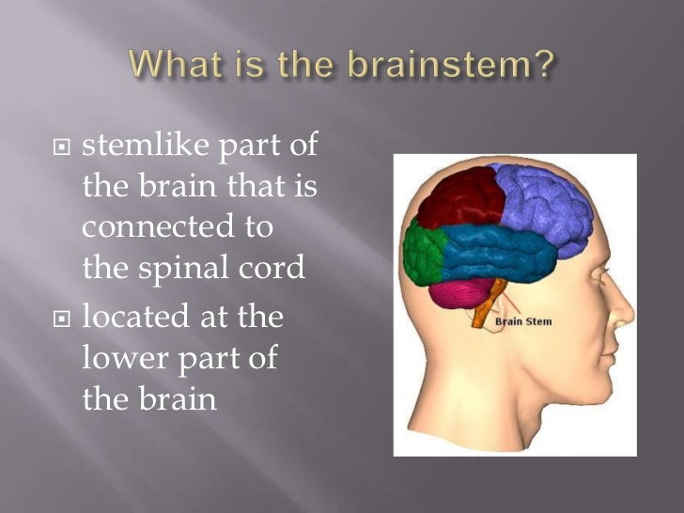
Control Center
Manages blood pressure, pulse, respiration
Arousal
Attention
Mood, Depression

Slide 14
What Is Normal Aging?
Normal Aging
Can’t recall a word. Describe the word to get it to pop up.
Give people time to process information. Go more slowly.
Slower to think.
Slower to do.
May hesitate more.
More likely to look before they leap.
Will know the person, but not find the name.
May pause when word finding
New data reminds me of old data
This Photo by Unknown Author is licensed under CC BY
Notes:
If we look at some of the signs we see if normal aging, we can see that even without a diagnosis of dementia driving might be a challenging.

Slide 15
We Should Talk
Notes:
Introduce the next objective on the steps on having the driving conversation.

Slide 16

Finding a Balance
Start Early
Go Slow
Notes:
Finding a Balance: The challenge with driving and dementia is to preserve a person’s sense of independence for as long as possible, while simultaneously protecting the safety of that person and others.
Take advantage of the time during the early stages to discuss options for when the person must limit and eventually stop driving.
A gradual shift in who drives can ease the transition for both family members and people with dementia. Although you may want the person with dementia to maintain control for as long as possible, it’s often easier to stop driving if driving has been reduced gradually over time.

Slide 17
Opening Lines
“Heath and safety first.”
“Driving isn’t what it used to be.”
“Did you hear about the car accident in the news today?”
Notes:
1.) When driving is placed within the larger context of other safety concerns, it takes the personal edge off.
2.) Try to find common ground by talking about road conditions, faster and heavier traffic areas. Possible to communicate that restricting driving due to other peoples issues not the older adults.
3.) Use news reports to INFORM, not scare, to explore family’s members attitudes about unfit drivers and who is responsible for helping them.

Slide 18
The Focus . . .
It’s more important to avoid accidents or death than to avoid unpleasant topics.
Notes:
Just read this slide.

Slide 19

Who should be the messenger?
Is the driver your spouse or your parent? Yes____ No____
Do you have the person’s best interests in mind? Yes____ No____
Do you know the person’s physical and cognitive condition? Yes____ No____
Do you know the person’s driving abilities? Yes____ No____
Do you have a good relationship with the person? Yes____ No____
Notes:
The person who answers yes to these questions may be in the most favorable position. Is it you or someone else?
Review that a professional will be able to answer “yes” to 3 of these questions.

Slide 20
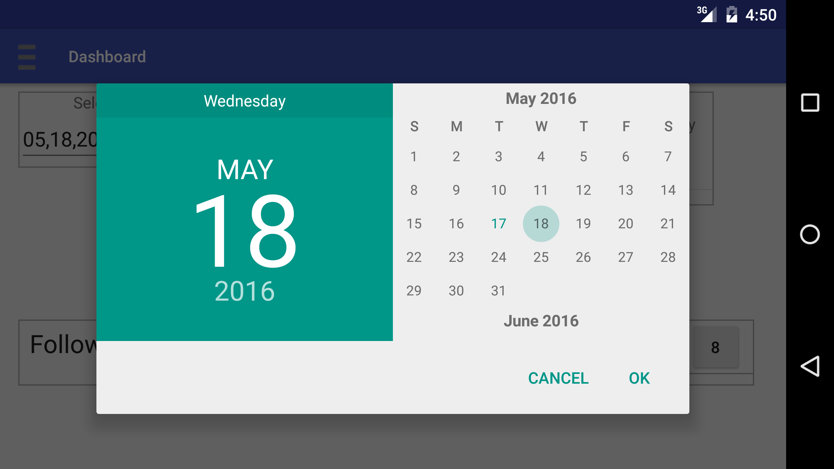
When is a good time to talk?
Change in frequency or severity of warning signs
  Not right after an accident/incident
Change in health, medication or cognitive status
  Not on the ride home from the appt
Change in financial situation or vehicle ownership
  Not at the DMV, law office or bank
This Photo by Unknown Author is licensed under CC BY-SA
Notes:
Focus on the when NOT to talk about driving, when emotions are high, when a problem needs to be solved.
This discussion needs to be it very own conversation not lumped into another one.

Slide 21

What do you want your conversation to accomplish?
Assure Older Adult of family’s willingness to help.
Discover Older Adults transportation needs.
Review observations of warning signs that retiring from driving may be needed.
Planning alternative transportation.
Notes:
Gather this information before the conversation and have it ready to be shared.

Slide 22
Professional Resources

Slide 23
AT THE CROSSROADS
Family Conversations about Alzheimer’s Disease, Dementia & Driving.
This guidebook helps families determine when it’s time for loved ones with dementia to stop driving and helps them cope with driving cessation.

Slide 24
Driving Behavior Warning Signs – When Noticed, How Often
1. Decrease in confidence while driving
2. Difficulty turning to see when backing up
3. Riding the brake
4. Easily distracted while driving
5. Other drivers often honk horns
6. Incorrect signaling
7. Difficulty parking within a defined space
8. Hitting curbs
9. Scrapes or dents on the car, mailbox or garage
10. Increased agitation or irritation when driving
11. Failure to notice important activity on the side of the road
12. Failure to notice traffic signs
13. Trouble navigating turns
14. Driving at inappropriate speeds
15. Not anticipating potential dangerous situations
16. Uses a “copilot”
17. Bad judgment on making left hand turns
18. Near misses
19. Delayed response to unexpected situations
20. Moving into wrong lane
21. Difficulty maintaining lane position
22. Confusion at exits
23. Ticketed moving violations or warnings
24. Getting lost in familiar places
25. Car accident
26. Failure to stop at stop sign or red light
27. Confusing the gas and brake pedals*
28. Stopping in traffic for no apparent reason*
29. Other signs:
* Stop driving immediately

Slide 25

Circle of Support

Slide 26

Agreement with My Family About Driving
To My Family:
The time may come when I can no longer make the best decisions for the safety of others and myself. Therefore, in order to help my family make necessary decisions, this statement is an expression of my wishes and directions while I am still able to make these decisions.
I have discussed with my family my desire to drive as long as it is safe for me to do so.
When it is not reasonable for me to drive, I desire_________________________ (person’s name) to tell me I can no longer drive.
I trust my family will take the necessary steps to prohibit my driving to ensure my safety and the safety of others while protecting my dignity.
Signed __________________________________ Date______________________
This Photo by Unknown Author is licensed under CC BY-SA
www.thehartford.com/lifetime
Notes:
When possible, include the person with dementia in the planning process. People are better able to respond to appeals to safety during the early stages
of the disease. This is a good time to discuss options for when the person must limit and eventually stop driving.
The agreement is not a legal contract, but allows families to discuss matters and agree on a course of action before a crisis occurs and while the loved one is still able to make decisions.

Slide 27
WE NEED TO TALK
This guidebook provides families with easy-to-use, practical information to help them plan ahead and initiate productive and caring conversations with older adults about driving safely.

Slide 28

Keeping Us Safe
Organization
Keeping Us Safe has dedicated itself to improving the mortality rate of older drivers and drivers with certain disabilities. We will accomplish this by working one-on-one with the older driver, and by developing and delivering education programs to older drivers and their families, geriatric professionals, and the public in general. We will further enhance our service to others by forming meaningful and beneficial partnerships with members of the geriatric and highway safety communities.

Slide 29

Beyond Driving with Dignity;
The workbook for older drivers and their families
Keeping Us Safe
877-907-8841
www.keepingussafe.org
Notes:
Mental Health America of the MidSouth has a person who can meet with Older Adults to conduct this driving Self Assessment. 3 Hour self assessment and it is designed for the Older Adult to be successful.

Slide 30
Keeping Us Safe's
Family Driving Agreement
Dear Family;
As I continue through the aging process, I realize there may come a day when the advantages of my
continuing to drive are outweighed by the safety risk I pose not only to myself, but also to other motorists.
I want to continue driving for as long as is safely possible, but when my driving is no longer safe, I will
trust: _____________________________
(name of trusted friend or relative)
when he/she tells me that I need to discontinue driving, or to continue driving with certain restrictions.
I will maintain my integrity by listening to and accepting this individual's driving-related
recommendations, thereby ensuring not only my safety, but also the safety of the motoring public.
Signed ________________________________ Date _____________ (your signature)
Signed ________________________________ Date _____________
(by person named above)
Witness ___________________________ Date _____________

Slide 31

Driver Rehabilitation Program
The Driver Evaluation and Rehabilitation Program at Pi Beta Phi Rehabilitation Institute evaluates driving potential and ability of people who have had injuries or conditions that could make driving unsafe. Examples include brain or spinal cord injury, stroke, amputation, low vision, dementia or learning disabilities. Our program uses adaptive driving equipment to increase safety.

Slide 32

Safety Tips and Resources for Drivers
Assessing Driving Ability
Refresh Your Driving Skills
www.aarp.org/safedriving
866-295-7274

Slide 33
Lynn Wood
Caregiver Support Coordinator
Mental Health America of the MidSouth
446 Metroplex Drive, Suite A-224
Nashville, TN 37211
Tel: 615.434.2710
lwood@mhamidsouth.org
Thank you.

Slide 34
Question & Answers

