Slide 1
How to Stay Out of Legal Hot Water
Notes:
Thank you for inviting me
Who I am and what I do

Slide 2
Do you feel like the sharks are circling and its all you can do to stay out of the water?
Notes:
Do you feel like the sharks are circling and its all you can do to stay out of the water?
Demands on your time are increasing and you are balancing many competing obligations.
THAT MEANS THERE IS MORE ROOM FOR ERRORS
Its difficult to see as many people as you need to see, render good care AND document that care
According to our data at SVMIC on over 15,000 physicians in 7 states, 39% of paid losses occur because of something that happened in the doctor’s office or the handoff between office and hospital.
You need to build up your defenses, before you need them. This is not about practicing “defensive medicine”. Its about being proactive in managing risks. This benefits the patient and keeps the sharks at bay.

Slide 3
SVMIC Claims with a Loss by Location
Notes:
LET ME GIVE YOU A LITTLE BACKGROUND ON WHAT MAKES UP THE CLAIMS WE SEE AT SVMIC.
Over the past approximately 5 years 39% of our claims where a loss was paid involved health care delivery, in whole or in part, in a physician office.
LET’S BREAK THAT 39% DOWN FURTHER:
19% of all of these claims occurred just in the physician office
13% involved multiple locations, usually hospital and office but in all cases at least 1 of the locations was a physician’s office.
Example scenarios involving multiple locations:
Patient was treated by physicians in several different offices, usually differing specialties, who all missed a diagnosis;
Delay in diagnosis in the office setting followed by a surgical mishap, often attributable to the delay;
Surgery followed by allegations of negligent follow-up care in the office.
The remaining 7% (Other) The claim arose in the office setting but involved non-clinical issues such as HIPAA violations and breach of privacy, Medicare investigations, and other ancillary claims.
So the bottom line is that 39% of claims were associated with an action or event that occurred in a physician’s office.

Slide 4
SVMIC Paid Claims in Physician Offices (last 5 years)
Notes:
LET’S DELVE DEEPER INTO THESE CLAIMS THAT OCCURRED AT LEAST IN PART, IN THE PHYSICIAN’S OFFICE -
What was the NATURE of the problem leading to payment of these claims
42 % are Diagnosis/Management Errors: Rarely are these the result of any one isolated action or deed, or a provider’s lack of knowledge or diagnostic ability. Rather, they are most often the result of poorly designed, ineffective or non-existent office systems and processes or of communication breakdowns.
Examples of system failures which contribute or lead directly to a diagnostic error are:
(1) referral or test results that fall through the cracks;
(2) patient arrives late for appointment turned away without provider approval;
(3) patient requiring follow-up leaves without scheduling appointment and is not tracked;
Examples of Communication failures contributing to failure to Dx:
(1) telephone conversations that aren’t documented in the chart;
(2) mishandling of phone messages (i.e. not triaged appropriately, call not relayed timely or not returned timely);
(3) misinformation in the chart (i.e. erroneous entry, records aren’t updated etc).
21% - Medication Related: wrong medicine, wrong dose, duplicative meds
19% - Surgical Procedure complication: Self-explanatory, primarily result of provider actions or inactions in an office procedure.
9% - Office Accidents: Patient falls off exam table, trips over a wire or cable, or there is an improper response to office emergency.
Errors are not usually the result of any one isolated action or deed, but rather the result of interaction of practitioners functioning in poorly designed systems.
NOT a clinical competency problem
ARE the result of breakdowns in systems and communication
Studies have shown: Lack of knowledge or diagnostic ability is rarely the culprit in mismanagement of patients, rather it is the situational environment or system interference which distorts the assessment of the relevant variables. (JAMA, Annals IM articles)

Slide 5
Poor Communication = Errors
44%: Direct breakdown in communications with patients or among colleagues during care
33%: Communications via medical record
21%: Lack of correct information in the medical record
12%: Inaccessibility of medical records
23%: Follow up issues with patients/colleagues
Notes:
LET’S LOOK AT COMMUNICATIONS A LITTLE FURTHER –
MOST ERRORS, are due to Poor communication of information (diagnoses, plans, followup, etc) Reducing these errors will go a long way towards keeping you “out of the courtroom”
In looking at past claims, studies identifies the following sources of communication breakdowns
largest source – direct communication with patients and colleagues – 44%
Next largest source – communications that occur through the medical record – inaccessible or inaccurate info- 33%
Incomplete patient information
Missing tests
--Direct or indirect communications are the cause of 77% of all errors
--And the remainder are followup issues with patients and/or colleagues
Could be discharge related info, follow up appointments, referrals to specialists, etc. -23%

Slide 6
Improve These Three Areas… And You Will Reduce the Risk of Lawsuits
Effective Communication
Consistent Office Processes and Systems
Good Medical Record Documentation
Notes:
THAT’S WHAT WE ARE GOING TO TALK ABOUT FOR THE REMAINDER OF MY TIME WITH YOU –
If you can improve your practice in these three key areas , you will significantly reduce your risk of lawsuits. There are three areas that we will focus on today.
Effective communication –
doctor-patient but also doctor-staff, and doctor-colleague
Managing your office processes and systems
Systems for following up on labs and referrals,
Handling patient requests and messages
Follow up – tracking and reminders
Medical records
Accurate, legible, accessible

Slide 7
Effective Communication
Notes:
Our first Risk Management point – Effective Communication
I cannot emphasize this enough: Communication is the difference between lawsuit and no lawsuit. When we look at the national data, we see that the number of adverse events far exceeds the number of lawsuits. We receive many calls in our office notifying us of adverse events and yet no suit ever comes of it. Why is that?
Why do some people sue and others do not?
Why do some physicians get sued repeatedly and others do not?
National data shows that 70% of lawsuits had the common factor of communication – a breakdown in communication. And that’s consistent with what we see in our area.
Background information:
There’s a long history of research associating poor communication with malpractice litigation. You may be a brilliant physician but if you don’t come across as a warm caring physician, your patients are less likely to forgive you if an adverse event occurs. Patients want physicians or caregivers who are caring, compassionate and competent……in that order. That is how they will judge you.

Slide 8
The Patient’s Point of View
Notes:
IT ALL COMES DOWN TO THE PATIENT’S POINT OF VIEW – ARE YOU FOCUSED ON THEM?
Research proves there is a connection between how satisfied patients are with their interactions with their physician, and how likely they are to sue.
Studies have found that about 3 out of 4 patients were upset with the physician for reasons such as
They didn’t think the physician cared about or understood them.
They were upset about how difficult it was to get an appointment, how they waited too long, how rude the staff was and how poor the doctor’s bedside manner was.
This already irritated patient is much more likely to sue when something goes wrong.
Patients are much less likely to sue doctors they like or feel they have a rapport with. When a doctor only has a few visits to establish rapport, simple things become important like explaining to the patient what is going to happen next and doing what you say you will do. Doing it consistently will build trust.

Slide 9
Harm + Bad Experience = Lawsuit
Good care + GOOD communication = LOWEST risk of lawsuit
Good care + BAD communication = HIGHER risk of lawsuit
BAD care + BAD communication = ALMOST CERTAIN lawsuit
Notes:
HARM PLUS BAD EXPERIENCE WITH THE DOCTOR = LAWSUIT
Believe it or note, the risk of being sued for malpractice has very little to do with how many mistakes a doctor makes.
Highly skilled doctors may be sued a lot while doctors who make lots of mistakes may rarely get sued.
At the same time, the overwhelming number of people who suffer an injury due to the negligence of a doctor never file a malpractice suit at all.
In other words, patients don’t file lawsuits because they’ve been harmed by shoddy medical care.
Patients file lawsuits because they’ve been harmed by shoddy medical care AND BECAUSE SOMETHING ELSE happens to them.
Source – “Watch your tone of voice” www.memag.com August 18, 2006, p. 41,44.

Slide 10
What Goes Wrong?
Problematic Communication Issues Identified by Plaintiffs in their Deposition
Feeling like the patient was deserted
Devaluing the patient or family’s views
Delivering information poorly
Failing to understand the patient/family’s perspective
Notes:
What is that “Something Else?” What Goes Wrong?
There was an interesting study published in the Archives of Internal Medicine.
Researchers looked at what happened after a lawsuit was filed and the patient or family member bringing the claim had a chance to tell their story. What exactly was it they complained of?
After the suit is filed the defendant physician’s attorney will take the deposition of the patient or their survivor. This is where you get to the heart of what the patient’s beef with the doctor or hospital really is. Problematic relationship issues with the provider were identified in 71% of depositions studied.
Four themes emerged :
The patient felt deserted by their caregiver (32%),
The patient and/or family felt their views were devalued (29%),
Information was delivered poorly (26%), and
The provider failed to understand the patient and/or family perspective (13%).
I know you don’t feel that way----why are they picking up on that? You need to examine your interactions with the patients to answer that question.
Beckman, et al. “The Doctor-Patient Relationship and Malpractice Lessons From Plaintiff Depositions”, Arch Intern Med. 1994;154(12):1365-1370.

Slide 11
How Patients Hear Us
Notes:
Let’s look at things from the patient’s side – How do patient’s hear you?
This is a shift from how you SAY what you need to say, to how Patients HEAR what you say.
Look at the slide – only 7% of what patients get from what you tell them comes from your words.
Body language and tone of voice have way more impact than the words we say.
Do you look at the patient or are you looking at your computer screen?
Do you convey empathy when delivering bad news?
Do you have “hand on the doorknob” syndrome?
****Beckman,1994; Vincent, 1994;
Hickson, 1992, Gallagher, 1995, Mazor, 2004; O’Connell, 2004.

Slide 12
“Good Care” vs. “Bad Care”
How does your patient feel about you?
How do you feel about your patient?
Notes:
Why is communication so important? Because patients are deciding how “good” the physician is and how “good” the care is the only way they know how – by how they feel about you and your office.
You want your patients to feel like you and your practice care for them. When something goes wrong (and it will), if your patients trust you, and if you explain what happened, they are willing to forgive.
On the other hand, if a physician is arrogant and the staff is rude, the patient decides to sue so “that it never happens to anyone else”.
Remember, when they asked plaintiffs in depositions “why did you sue?” it all boiled down to communication – he or she deserted me; he didn’t care about me; he talked to me in such a non-caring way etc. etc.
A patient’s perception of how good a physician is depends on how the information is given to them – not only what is said, but how it’s said.

Slide 13
Creating a Positive Perception Begins at the First Contact
Use every opportunity to build trust
Warmly and sincerely greet patients
Monitor waiting/exam room times
Advise patients of delays
Use the patient’s name during the encounter
Make eye contact when speaking to patients
Respond quickly to patient questions/concerns
Treat patients with respect
Notes:
Use every opportunity to connect with your patient and create a bond of trust. All of these factors apply equally to the staff. These are the basics. Let your staff expressly know you expect them to follow these simple rules.
Decades of research shows – if a patient trusts his or her physician, he/she is much more likely to forgive a mistake. The formula for a lawsuit is a disappointing outcome and a physician who has lost the benefit of the doubt.
Patients give the benefit of the doubt to physicians they believe to be honest, caring and competent. They form an opinion as to those things based upon the physicians interpersonal and communication skills. Good listening skills and clarity of message helps build such a relationship.
We have claims reported to SVMIC that involve lapses in patient safety or medical misadventures, but which never result in a lawsuit, primarily because of the relationship of trust built by the physician along with the compassionate care provided.

Slide 14
Don’t Forget the Family
Who will ultimately file the lawsuit?
How is your relationship with the family?
Who comes with the patient?
Is there anyone else you’d like me to speak to?
Document when you talk to the family!
Notes:
You may have the best relationship in the world with your patient but if they die its their survivors who will bring the law suit. What relationship do you have with them?
Think about:
Who comes with the patient?
Are they in the exam room? Does patient defer to their opinion?
Does the patient refer to a family member frequently who does not accompany them? Ask, “Is there anyone else you’d like me to speak with about this?”
DOCUMENT CONVERSATIONS WITH SIGNIFICANT FAMILY, Particularly their agreement to a plan of treatment.
Put their name and relationship in the chart “discussed with pt and [family member]…..”

Slide 15
The Moral of the Story
A patient’s perception of the quality of care they receive depends greatly on the
communication and interpersonal skills
of the physician and their staff
Notes:
Moral of the story, and it can’t be repeated often enough!
A patient’s perception of the quality of care they receive depends to a large extent on the communication and interpersonal skills of the physician and staff.

Slide 16
Consistent Office Processes
Notes:
OUR SECOND RISK MANAGEMENT POINT……
Inconsistent processes lead to inconsistent results.
If every physician in the practice has a different routine or there is no process at all, mistakes happen. Lab or xray reports get placed in the record without the physician’s knowledge. Referrals don’t happen, surgeries don’t get scheduled, patients are not contacted for follow-up.
It’s important that everyone in the office know what the process is for handling patient’s test results, appointment and referral scheduling, and phone messages and requests.
These processes should become part of “Automatic thinking.” Automatic thinking is what happens when actions are repetitively reinforced – for example, that’s how we can arrive at home and not even recall how we got there. We take the same path each day and “automatic thinking” takes over to get us home without having to make conscious decisions at every step along the way. You want your staff to become “automatic thinkers” to handle information flow and office processes. Reinforces good habits.

Slide 17
Tracking
Diagnostic tests
Patient referrals
Patients requiring follow up
“No-shows” or cancelled appointments
“No news” is NOT “good news”
Notes:
One method for avoiding those dropped balls is a TRACKING SYSTEM.
What happens when lab or other diagnostic testing is returned?
Who gets the report, who makes sure the physician sees it?
More important, how do you know when a report on a test you’ve requested doesn’t come back to you?
A simple log system can take care of this.
Failure to track test results is a routine scenario in cases involving failure to diagnose cancer (for example).
An x-ray, CT, or mammogram is ordered and the report doesn’t get back to the office.
The doctor’s office has no system in place to monitor which tests it has outstanding.
Add to that the fact that some patients AND DOCTORS operate on the “no news is good news principle”.
So follow up, and enlist your patients’ help too. Tell them if they haven’t heard from you by a certain date then they should call. The patient is your safety net.
Same for follow-up visits & referrals. Track & develop a system for responding.

Slide 18
Information Overload
70% of physicians receive more alerts from their EMR than they can effectively manage
Notes:
INFORMATION OVERLOAD
Another Study looked at EMRs We might expect that electronic systems would help with follow up. Not necessarily so. “Information Overload” is a real problem
2590 PCPs participated in this study.
They reported that the median number of EMR “alerts” they received each day was 63;
Almost 87% thought the quantity of alerts they received to be excessive, and
70% reported receiving more alerts than they could effectively manage (A marker of information overload).
These findings suggest that missed results in EMRs might be related to information overload from alert notifications, electronic handoffs in care, and practitioner perceptions of poor EHR usability.
MAKE YOUR EMR WORK FOR YOU, NOT THE OTHER WAY AROUND – make changes as needed to maximize productivity. Evaluate the flow of info – what is truly important and needs alerts? Who should get them?
Source:. “Information Overload and Missed Test Results in Electronic Health Record–Based Settings” : JAMA INTERN MED/VOL 173 (NO. 8), APR 22, 2013 WWW. JAMAINTERNALMED.COM

Slide 19
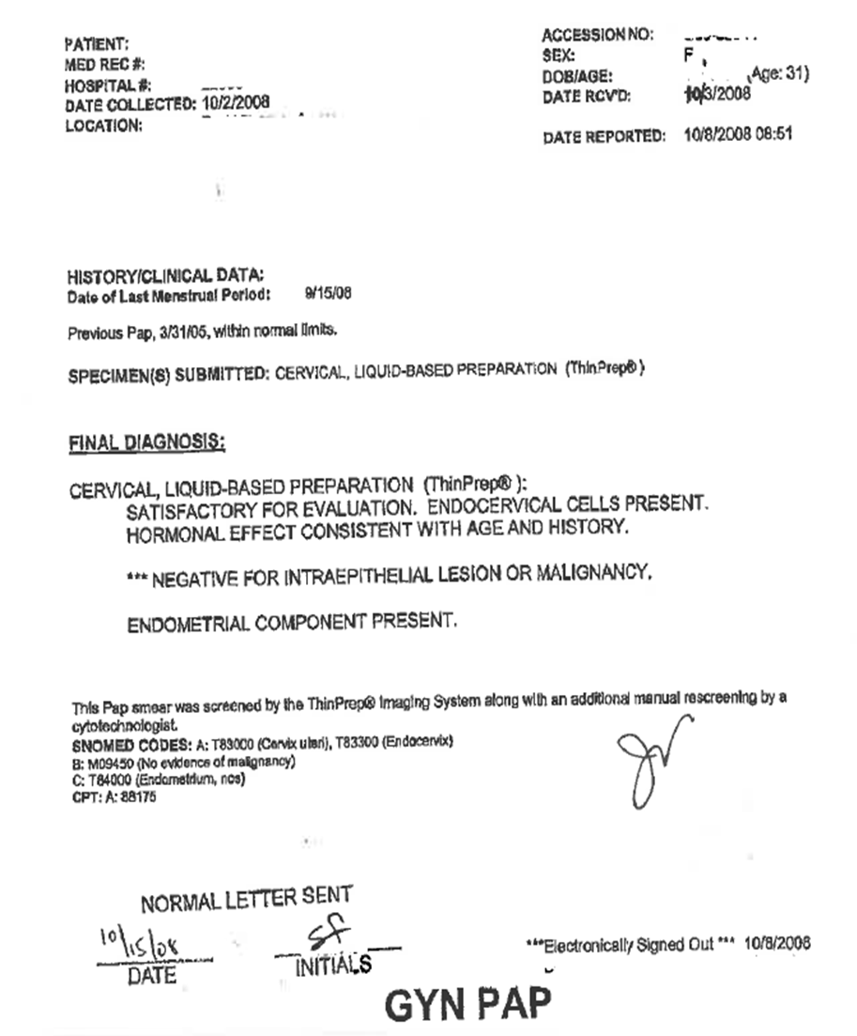
The Importance of Test Handling
31 year old female
2008: normal report signed (although not dated)
Staff documented patient notification of test results
Notes:
This is an actual case that has been de-identified. Patient had annual pap tests. Look what happened.
Slide 1: At this pap in 2008, it was normal. The staff documented that the patient was notified, the doctor signed it, and it was filed. So far so good.
Slide 2: This very compliant patient comes back in 2009. This time we see atypical cells on the pap smear. The physician was waiting for an HPV test to come back before taking action on this abnormal result. Unfortunately, the HPV test result did not come back, and this this test was filed in the patient’s chart.
Slide 3: In 2010, the patient was diagnosed with invasive squamous cell carcinoma. She underwent radical abnormal hysterectomy at the age of 31, and began further treatment for her cancer.
Source: SVMIC. Case 053650

Slide 20
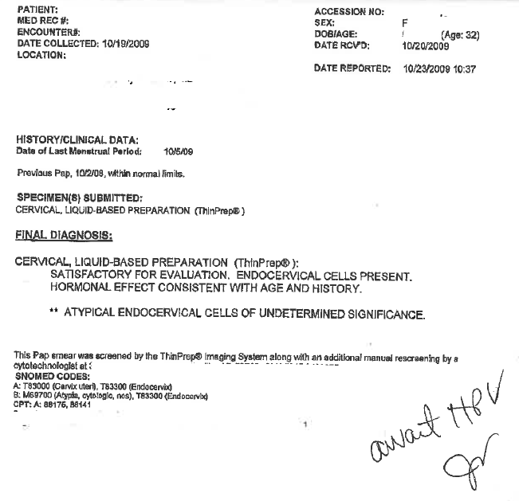
The Next Year (2009)
This abnormal report was signed (although not dated)
Report was initially set aside to await HPV
But in an effort to “clean up”, report was sent to medical records
Medical records staff saw it had been signed
Report was filed… even though documentation of patient notification was missing
Notes:
This is an actual case that has been de-identified. Patient had annual pap tests. Look what happened.
Slide 1: At this pap in 2008, it was normal. The staff documented that the patient was notified, the doctor signed it, and it was filed. So far so good.
Slide 2: This very compliant patient comes back in 2009. This time we see atypical cells on the pap smear. The physician sees the report and notes he is waiting on the result of an HPV test also.
The physician was waiting for an HPV test to come back before taking action on this abnormal result. Unfortunately, the HPV test result did not come back, and this this test was filed in the patient’s chart.
Slide 3: In 2010, the patient was diagnosed with invasive squamous cell carcinoma. She underwent radical abnormal hysterectomy at the age of 31, and began further treatment for her cancer.

Slide 21
2009
Their tracking system did not track both tests
HPV test never returned
As it turned out, the physician never saw the test results
This clinic allowed clinical staff to screen and report only the “abnormals” to the physician
Patient was not notified of the test results
No treatment ensued
Notes:
This is an actual case that has been de-identified. Patient had annual pap tests. Look what happened.
Slide 1: At this pap in 2008, it was normal. The staff documented that the patient was notified, the doctor signed it, and it was filed. So far so good.
Slide 2: This very compliant patient comes back in 2009. This time we see atypical cells on the pap smear.. Unfortunately, the HPV test result did not come back, and this report was filed in the patient’s chart. The physician was not concerned that he saw any HPV report as his staff was only to report “abnormal results” to the physician. They did not report to him that the HPV never came back.
Slide 3: In 2010, the patient was diagnosed with invasive squamous cell carcinoma. She underwent radical abnormal hysterectomy at the age of 31, and began further treatment for her cancer.

Slide 22
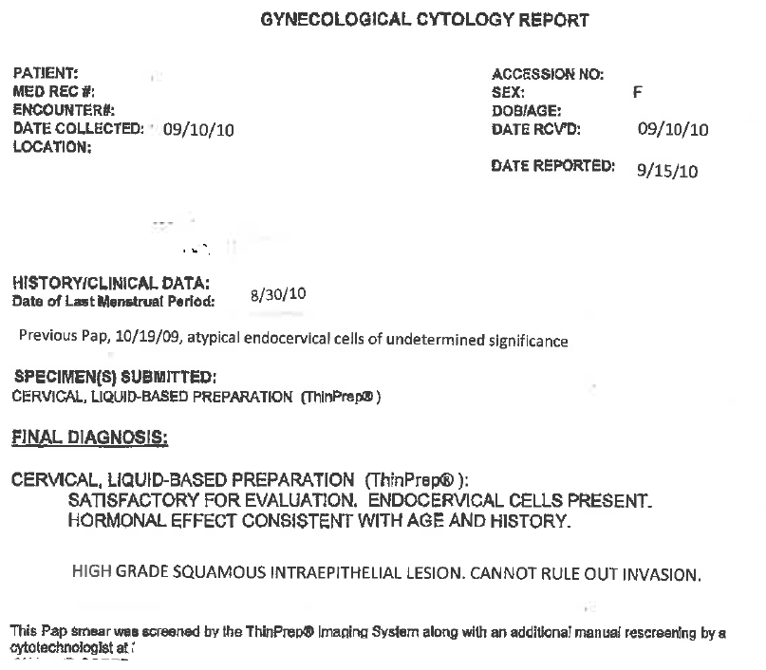
The Following Year (2010)
Further testing confirmed the patient had invasive squamous cell carcinoma
Patient underwent radical hysterectomy and was unable to have children
A Lawsuit Was Filed Alleging:
Failure to have a tracking system including notifying patient of test results
Breach in standard of care – failure to follow up on abnormal pap results
Notes:
Slide 3: In 2010, the patient was diagnosed with “high grade squamous cell carcinoma, cannot rule out invasion”.
Source: SVMIC. Case 053650
What happened – You can guess………
Further testing confirmed invasive squamous cell carcinoma
She underwent radical abdominal hysterectomy at the age of 31, and began further treatment for her cancer.
Lawsuit filed alleging:
Failure to have tracking system including notifying patient of test results.
Breach in standard of care – failure to follow up on abnormal Pap test results
Source: SVMIC. Case 053650

Slide 23
Communicating Information
Do you check your in-box/task box at least daily?
If a staff member is not in the office (sick or on vacation), is another employee designated to check his/her task box?
Do you realize tasking/messaging is a legal part of the medical record?
Be prudent with your choice of words.
TASKING
Notes:
How would that information in our last example be communicate now? Likely by some sort of TASKING TO THE APPROPRIATE PERSON.
We talked about information overload – you want to FIRST design your system so that the tasks you get are just the important ones.
Check those task inboxes and be sure your staff does too.
Who’s checking on the in-boxes of staff on vacation or out sick? Don’t let them languish untended.
Paper reports – sitting in an unlooked at in-box on the desk of a nurse who’s on vacation??
The tasks are part of the electronic record - Don’t say anything you wouldn’t want to hear read out loud from the witness box!
“This person has called so much, they are driving me crazy”
As Sgt Joe Friday said on Dragnet – “just the facts please”

Slide 24
Risks Associated with Tasking
67 year old female on Coumadin
Thursday
Friday
Saturday
Sunday
Monday
Tuesday
Seen in PCP office
Fingerstick INR shows 6.2
Blood also sent to the lab
PCP was not in the office
Nurse tasked PCP about the INR result
PCP saw message in the morning
Tasked “patient instructions” to the nurse
PCP left for a vacation
Nurse took a vacation day (PCP wasn’t aware of this)
Nurse saw physician’s instructions
Nurse notified patient and family
Patient died
Notes:
An example of an unattended task. The system was in place to follow up on the test results, route them to the physician and all that was done.
MULTIPLE SLIDES
67 YOF on Coumadin
INR done THURSDAY afternoon = 6.2. Nurse messages the PCP
PCP sees it on FRIDAY and tasks his instructions back to the nurse
Nurse is off on FRIDAY and doesn’t see it until MONDAY. When she notifies the patient with new instructions.
PCP goes on vacation, not aware that the instructions were not relayed to the patient until Monday.
The patient dies on TUESDAY
BREAKDOWN – someone in the office took a day off……..

Slide 25
Unattended Task Boxes
Monitor all task boxes at the end of the day to ensure no critical values have gone unnoticed.
Assign another reviewer the responsibility for checking the staff’s task box during his/her absence.
67 year old female on Coumadin
Thursday
Friday
Saturday
Sunday
Monday
Tuesday
Seen in PCP office
Fingerstick INR shows 6.2
Blood also sent to the lab
PCP was not in the office
Nurse tasked PCP about the INR result
PCP saw message in the morning
Tasked “patient instructions” to the nurse
PCP left for a vacation
Nurse took a vacation day (PCP wasn’t aware of this)
Nurse saw physician’s instructions
Nurse notified patient and family
Patient died
Notes:
THIS CLINIC HAD A PROCESS BUT IT FAILED.
Part of your process should be to ensure all inboxes, be they paper on the desk or electronic in the EMR, are checked at the end of every day.
REMEMBER…….
You are legally responsible for the results of every test you order. You must ensure that the results of that test are reviewed and communicated to the patient in a timely manner.
PATIENT PORTALS – NEW TOPIC….NOT A SUBSTITUTE FOR COMMUNICATING INFO DIRECTLY –
from a customer service and a risk management perspective, do not rely solely on patient portal to communicate normal info.
Never a way to communicate abnormals

Slide 26
Telephone Call Handling
Written policies for telephone response personnel
All calls should be directed to a provider or written protocol for all clinical staff allowed to give patient advice
Do you carefully prioritize phone calls for the physician to ensure urgent ones are addressed immediately?
Do you document after hours calls?
Notes:
Appointment scheduling triage example - Triage by front desk without policies:
On a Saturday, Mr. Smith comes to the ER with complaints of fever, malaise and swollen painful joints. He is admitted to 23 hour observation by the hospitalist and a blood culture is drawn, among other things. His temp returns to normal and the swelling subsides somewhat, so he is discharged with written orders to call his primary care doctor, Dr. Jones, and be seen Monday or Tuesday. On Monday, the blood culture comes back positive for MRSA and the result is phoned to the PCP, who tells the nurse to phone Mr. Smith to come in ASAP to be seen and started on antibiotics. The nurse tries but cannot reach Mr. Smith at any of the numbers on the chart. In the meantime, that same day, Mr. Smith calls to get an appointment with Dr. Jones and speaks to the front desk personnel. He is told that they do not have an opening until Friday afternoon and he is given an appointment then. Mr. Smith is asked for a number where he can be reached to put in the appointment schedule and tells the front desk that he is not feeling well so he is staying at his son’s house and gives that number.
The nurse never reaches Mr. Smith and does not know he called to schedule an appointment. The front desk personnel never knew the nurse was looking for him. By the time Mr. Smith comes for his Friday afternoon appointment, he is septic. Dr. Jones immediately sends the critically ill Mr. Smith to the hospital but he dies from the delay on getting him treated. The case is settled.
NEW OFFICE PROTOCOL – Nurse will advise front desk of patients expected or contacted.

Slide 27
After-Hours Calls
Document at time of the call
Date, Time, Complaint
Advice, Prescription, Referral
Get that note in the medical record!
Notes:
This is an important process often overlooked. What happens to the calls taken after hours??
Information on a message pad at home – take to the office to scan into the chart
Text message (on a secure text server) to the office staff, or email (secure) the office
Call the dictation line and dictate a note
Leave a phone message for your staff
DO NOTHING!

Slide 28
Good Medical Record Documentation
Notes:
Our Third Risk Management Point Today – Medical Record Documentation
Don’t find yourself behind the eight-ball in a medical malpractice lawsuit, where you rendered perfectly appropriate care but the chart does not reflect that fact.
“Jurors don’t expect a doctor to remember every patient who’s walked through the door, but when it comes down to a credibility contest, the patient’s testimony tends to carry weight. All you’ve got is the medical record to save you.”
PHYSICIAN HEAL THYSELF. P. 57

Slide 29
Why Discuss Documentation?
Medical record documentation posed the most frequent risk management issue
Second most frequent – processes and procedures for lab test/referrals, scheduling and follow-up
Notes:
Why Discuss Documentation along with processes and procedures??
Good medical record documentation should follow naturally from having good processes and procedures. Each step is documented in sequence.
The documentation should follow the information, from creation to documentation.
Medical record documentation posed the most frequent risk management issue.
Second most frequent – Processes and procedures for lab test/referrals, scheduling and follow-up
Medical Group Mgmt Association Study confirmed this…. Diamond, Robin, “Practice managers play key role in patient safety”, MGMA Connexion, Mar. 2012: 52-54.

Slide 30
Medical Records
The medical record could be the most important piece of evidence in a malpractice trial.
Notes:
The MR is the single most important component in providing continuity of care.. In a med mal trial, the chart makes up nearly the entire documentary evidence a plaintiff’s lawyer uses when attempting to prove medical negligence in the care and treatment of his client – formerly your patient. Juries put incredible stock into what the MR says – it is considered to be objective and unbiased since it was written to explain what happened.
IT IS THE ONLY DOCUMENT THAT PROVIDES A CHRONOLOGICAL BLOW-BY BLOW HISTORY OF THE TREATMENT RENDERED.
The medical record is generally held to be more objective and unbiased than your verbal testimony since it was written when your only obligation was to record the facts.
This applies to the defense as well. At SVMIC, when there is a lawsuit filed, a team of highly trained nurses will sort through the medical record and create a timeline of events. Every defendant's records will be chronologically sorted in this way.
It’s a land mine or a gold mine.

Slide 31
Basic Considerations
Legible
Accurate
Objective
Complete
Timely
Notes:
Legible – INDEFENSIBLE IF NOT – PORTRAYS SLOPPY CARE
Accurate –
CHECK MEDS EACH VISIT (NOT “SAME”), REASON FOR VISIT IN PATIENT’S WORDS, UPDATE CHIEF COMPLAINT EACH VISIT IN PATIENT’S OWN WORDS NOT SOME OFFICE STANDARD ABBREVIATION
Objective – REMIND STAFF THAT TASKING IS A PART OF THE MR; COMMENTS LIKE “SHE HAS CALLED AGAIN”, COMPLAINING AGAIN” “tendency to complaint”, “once again, patient cannot tolerate ”CAN BE PERCEIVED AS BIASED; ONLY ACCEPTED ABBREVIATIONS
Complete – INCLUDE All MEDS, REFILLS, SAMPLE MEDS, PATIENT EDUCATION
Wordy entries are not necessarily better – could be a reflection of self-serving attempt to cover up
Timely – COMPLETED SAME DAY – BECOMING PROBLEMATIC BECAUSE PHYSICIANS CONTINUE TO USE PAPER METHODS AND PLAY CATCH UP IN EVENING With EMR. (A recent study of physicians' EHR "workarounds" found that some doctors who feel uncomfortable with EHRs create paper "shadow" charts.^{[2]} Doctors use these documents to track patient progress or as guides to medical decision-making, believing that they're more accurate and up to date than the EHR information. Such an approach is understandable, especially if you have an unsatisfactory EHR. But maintaining both paper and electronic records can lead to other problems, such as missing information in one or the other or both. "Once a patient record has been converted to the EHR, that should be the official document," says Rosenberg. "Having 2 charts is fraught with potential problems.“ Another workaround, scribbling notes on pieces of paper, usually results from an IT person configuring the system without input from clinicians, Nelson says. Source: Doctors' 10 Biggest Mistakes When Using EHRs. Medscape. May 01, 2013.)

Slide 32
Common Documentation Issues
Patient non-compliance
Informed consent
Abbreviations
Changes to the medical record
EHRs
Notes:
Let’s talk about documentation for a few minutes and touch on a few of the main problem areas we see in defending claims–
Patient non-compliance – how are you documenting and tracking this? Goes back to what we talked about earlier……..
Informed consent - and its corollary INFORMED REFUSAL
Abbreviations in the record
How to make changes to the records.
EHRs – could spend a whole day on this alone but I want to highlight the main problems.

Slide 33
Pitfalls with Electronic Records
Templates
Cloned notes
Over documentation
Contradictions
Notes:
The EHR has the potential to advance the practice of good medicine. There’s no question that it has improved legibility, organized records, and made records more easily available. However, when new technologies are adopted, there are some unintended consequences. Real and potential liability risks are beginning to be recognized and it is important for physicians to become familiar with them. (Source G2 EHR seminar, 2013)
Let’s take a few minutes to review some of the common pitfalls along with examples of each within an actual electronic medical record.
covering for other staff if every physician has his/her own processes. “Automatic thinking” is what happens with all of us – that’s how we can arrive at home and not even recall how we got there. We take the same path each day and “automatic thinking” takes over which is how we can get home without realizing everything about our trip. If we varied our trip home each day, this would be less likely to occur. Sooner or later, “automatic thinking” make take place by your staff; if every physician’s process is a little different, this can lead to reports being placed in the record without the physician’s knowledge.
Poor communication between providers:
During an exam, the UA showed blood and 4+ protein. Mother instructed to return with child to office next day so the test could be repeated but Mom failed to return.
Child seen again 6 months later , seen by a different MD in the group and no study done then. This MD did not see anything in the previous note about the need to f/u on the abnormal test.
The next UA was done 5 months later (now 11 months since first UA) and again abnl. There was no note of any f/u or referral.
13 more months go by and another UA done and abnormal. This was repeated and showed modest improvement but still abnl results.
Another 13 months go by and at this visit, another UA was done – this time with no blood and trace protein. Serendipitously, however, the child was referred to endocrine at the next annual visit because of short stature.
The specialist found a UA with 4+ protein and referred to nephrologist.
Nephrologist then did serial UA’s and uncovered a Family hx of kidney removal in cousin at age 11 for unknown reason. A renal bx confirmed FSGS(focal segmental glomerulonephrosclerosis) with 30% scarring of total glomerular count. This child would need kidney transplant within 10 years. Child had "focal segmental glomerulosclerosis," an incurable, inherited disease.
This clinic used an EMR and within the practice a child could be seen by any one of the pediatricians - Physician to physician communication is heavily dependent upon good notes in the EMR including notation of follow up items that would need to be followed. This particular child kept coming in for annual physicals but no one focused on the abnormal UA from several years back. So we have a violation in the SOC for failure to have a f/u system for abnl test results even though the experts determined that there was probably no definitive link between that deviation and the resulting harm to the child. This kind of disease would likely have progressed. The plaintiffs case alleged a failure to treat the patient's proteinuria, leading to worsening of the plaintiff's renal disease and short stature. Had the proper systems for f/u of patients who miss f/u appointments been in place, this would have been a defendable case.

Slide 34
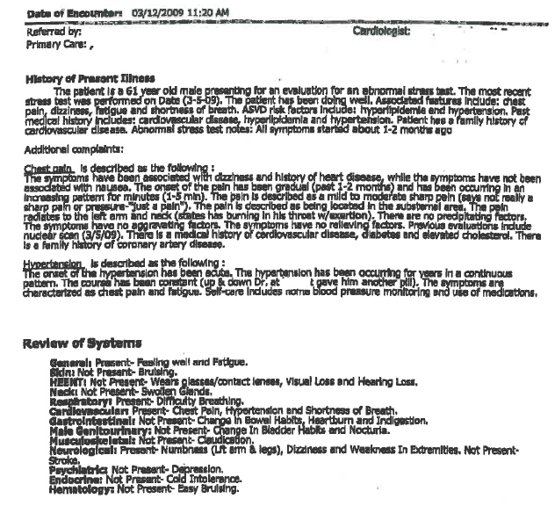
61 yom seen for evaluation after abnormal stress test
Chest pain
Inconsistent documentation
Hypertension: “The onset of the hypertension has been acute.”
BUT …
“The hypertension has been occurring for years…”
Notes:
Example - These are real medical records from a lawsuit. You can see why a jury looking at this would wonder what the REAL story was with this patient and if the doctor was aware of it. These types of EMR entries are not unique, but are unfortunately quite common.
CASE STUDY:
This patient presented to a cardiologist in March 2009 for chest pain and an abnormal stress test. The history of present illness was actually quite thorough in its description of the chest pain. Then they switch to a template that is confusing – for example – the evaluation of hypertension states “the onset of the hypertension has been acute. The hypertension has been occurring for years…..” Another example of confusing documentation in in the review of systems. “Feeling well. Fatigue”. Which is it?

Slide 35
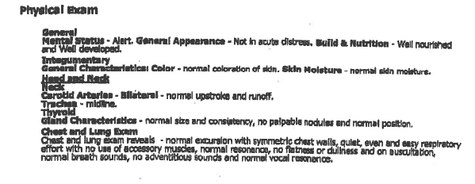
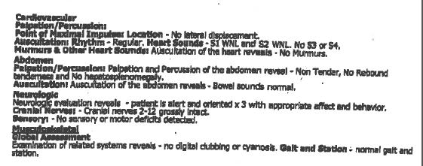
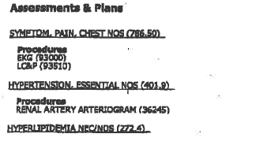
Physical Exam includes
Chest/Lung
Cardiovascular
EHR automatically generated exam findings (cranial nerve checks, abdominal assessment) which weren’t performed
Was the physician aware of what was printed in the note?
Narrative note: None
Treatment plan: None other than CPT codes
No documentation of consent discussion for cardiac cath
Notes:
In a continuation of the same office note by the cardiologist, we see that selection of one thing on the template may result in an exam which may not be an accurate reflection of what actually took place. Were cranial nerve checks and an abdominal exam done?
Autopopulation occurs when the EMR template automatically includes elements of a comprehensive exam, regardless of specialty. If the physician does not take time to deselect boxes, the physical exam findings may not correspond with the exam performed. In this example, this results in significant cardiac findings buried within the note.
In this patient with significant cardiac symptoms, the documentation is restricted only to the use of the template. The physician’s overall impression is not included nor a definitive treatment plan other than a CPT code listing procedures.
A narrative description would be advisable that includes all these things.
A cardiac cath is planned - Was there a discussion with the patient or family during this visit, including a contemporaneous discussion of specific risks, benefits, and alternatives? There is no indication any of this took place and a lack of informed consent claim would be hard to defend.
IN SUM – this is a beautiful looking note but not a very good documentation of the visit.

Slide 36
Information Carryover? Verify!
Any content carried forward should be reviewed for accuracy
Examples of entries repeated at each visit for a 3 year period for a cancer patient
History: “patient was diagnosed with renal cancer one month ago”
Medications: “no new medicines prescribed”
Notes:
Defense attorneys will tell you that it’s very difficult to explain inaccurate entries to a jury. When an error is made, it can be magnified many times over if the entry is carried forward over multiple visits. An addendum may have corrected the original error but it won’t necessarily show up again if the incorrect information is carried over for months or even years of visits. Often the entry is no longer timely, as we see with the example on the left. The patient wasn’t diagnosed one month ago for 3 years!
Medication reconciliation is extremely important! Be sure that these medication lists are current. If a medication is stopped but not removed from the list, this can lead to a picture of a patient on multiple meds. Or it may lead to inconsistencies between the narrative and the medication list, as would likely occur in the second example above.
Besides just impacting patient care, when a jury sees these types of documentation errors, CREDIBILITY of all entries in the record is questioned. Implies provider is not paying attention. VERIFY ALL ENTRIES THAT ARE CARRIED FORWARD.

Slide 37
Electronic Records – Tips and Tools
Verify identities
One chart at a time
Train staff
Read what you wrote
Chart audits
Notes:
EMR Tips and Tools - Some basic hints for working with an EMR:
Do you have the right patient?
Consider using photography for patient identification; justify over concerns of identity theft
Only open one electronic record at a time – multiple open charts magnifies opportunity for error
Train the staff on the system, and perform retraining as needed.
New employee training
“Superuser” with advanced training and knowledge
Audit as you go along
READ what you just entered.
Perform periodic audits – pull a record and see what it looks like from front to back.

Slide 38
Timely Completion of Notes
Hazards of completing notes after the Date of Service
Memory can interfere with accuracy
Any intervening event can make notes look “self serving”
Easily leads to “cookie cutter” brief notes
Cannot bill prior to completion of the record – level of service?
But – not documented does not mean not done
Notes:
Your schedules are busy and you are trying to see as many patients as you can safely see. Add the challenges of documentation and its easy to get behind. Let me caution you about some of the risks associated with completing notes after the day or time of the visit…..
Memory can interfere with accuracy
Any intervening event can make notes look “self serving” – did you go back to cover your tracks?
EX - pt w/CP seen at 10am – musculoskeletal?; goes to ED dies at 5pm; you don’t get around to writing note until 8pm.
REMEMBER – EMR logs are unforgiving. They will tell what you entered and when, when you looked at the record, etc.
LOGS are OFTEN requested in lawsuits
Easily leads to “cookie cutter” brief notes
Cannot bill prior to completion of the records – level of service coding?
BUT - - Can’t document everything. NOT DOCUMENTED DOES NOT EQUAL NOT DONE – This is a billing rule of thumb. You are not expected to record every word and action in the medical record, but you better get the main ones, or the ones that signal what your custom and habit might be.

Slide 39
Patient Non-compliance Challenges
Missed appointments
Missed referrals
Refusal to follow medical plan

Slide 40
Patient Non-compliance Solutions
Tracking
Document recommendations
Document follow-up efforts
Combat health illiteracy
Teach back method
Plain language
Written materials, elementary level
Visit summary
Notes:
Patient Non-Compliance Solutions –
FIRST: Systems: Tracking and follow-up – be sure routines and processes are in place
Document your recommendations in the record
Document your follow up letters – letters or phones calls
Combat Health Illiteracy – is failure to comply due to failure to understand?
Ask them to explain things back to you (teach back)
Use plain language
Use written materials when possible – on an elementary reading level
Provide a short written visit summary – EMRs may do this, or jot key findings on paper.
Is it time to terminate the patient because they don’t seem to agree with your plan of care?

Slide 41
How much is enough?
Patient follow-up
Two documented calls
One letter
Severity of problem may require more
Correspondence
Regular vs. return receipt?
Notes:
Here is a question that I am asked all the time - How far do you have to go to get a patient to follow your recommendations?
Depends on the severity of the issues involved
GENERAL RULES – 2 calls and a letter.
Letters – regular AND certified
New dx of cancer, for example, may require more efforts. Sometimes you have to spell it out in graphic terms (“you will die if you don’t get treatment”). No response can then be taken as an informed refusal of treatment.

Slide 42
Informed Consent
Benefits
Risks
Alternatives
Consequences
Layman’s terms
Informed refusal
Notes:
Consent is a process not a form
A discussion of benefits, risks, alternatives and consequences
Physicians commonly forget alternatives, if there are any. Doing nothing is an alternative.
Use layman’s terms and bring family into the discussion when appropriate
Consent – express and implied – if they go thru with it then they have impliedly consented. But is it informed?
Do not make guarantees – “You’ll be fine”……maybe not. “Don’t worry” ……. why not?
DOCUMENT the conversation; Handouts are good, if its something very standard, ie: elective tonsillectomy.
A hospital consent is NOT the same as an informed consent.
INFORMED REFUSAL – A VERY IMPORTANT AND UNDER-DOCUMENTED ACTION
A patient has the right to refuse what you want them to do.
KEY is to document that you have told them the risks and problems that may, or are likely, to occur.
Same concept as informed consent.
“I have explained the potential consequences of declining to do XX and patient desires to forego [test, meds, hospitalization, etc].
Have patient sign just like an informed consent.

Slide 43
Documentation Do’s
Update problem, medication lists
Document consistently, same location
Structure HER prompts to help you
Write it out – narrative format
Use the patient’s own words
Notes:
A quick review:
Update problem and medication lists at every visit
Document consistently, same location in the record, same format if applicable
Structure EHR prompts to help you – your system design is key
Write it out – narrative format. VERY IMPORTANT on EVERY RECORD
Use the patient’s own words – use quotation marks.

Slide 44
Documentation Don’ts
Erase or destroy entries
Copy and paste
Rely exclusively on templates
Use unapproved abbreviations
Do not make any self-serving entries or alterations to the record if litigation is threatened
Notes:
DON’T:
Erase or destroy entries – the corrected entry should be visible
Copy and paste – repetitive entries are always suspect and make the whole record suspect
Use unapproved abbreviations – don’t make up your own shorthand.
Do not make any changes to the record if litigation has been threatened – in fact that chart should be sequestered in office manager’s office so prevent additions to the chart or alterations etc..
Alterations – looks like trying to cover up or boost someone's opinion of the way you handled it. Writing sideways in the margin looks like a late entry without annotation of that. Doodling, exclamation points, drawing of irrelevant pictures is very hard to explain if there is an adverse event.

Slide 45
Medical Records
The medical record could be WILL BE the most important piece of evidence in a malpractice trial.
Notes:
And remember::: You have seen this slide before but it bears repeating!
The medical record WILL BE the most important piece of evidence in a malpractice trial.
In a med mal trial, the chart makes up nearly the entire documentary evidence a plaintiff’s lawyer uses when attempting to prove medical negligence in the care and treatment of his client – formerly your patient. Juries put incredible stock into what the MR says – it is considered to be objective and unbiased since it was written to explain what happened. Don’t do anything that challenges that presumption of objectivity and validity!!
IT IS THE ONLY DOCUMENT THAT PROVIDES A CHRONOLOGICAL BLOW-BY BLOW HISTORY OF THE TREATMENT RENDERED.
It’s a land mine or a gold mine.

Slide 46
What is Your Lawyer’s Diagnosis?
Notes:
…….And if the medical record doesn’t spell it out, some lawyer will.
“What is your lawyer’s diagnosis?”

